Slide 1
TECHNICAL ANALYSIS SCREENER_2 HEIKIN ASHI

Slide 2
GROUP MEMBERS
Baradi Bindhu
Bana Vijaya Lakshmi
Uppu Nimeesha
Remala Venkata Laxmi Nikhila
Rontala Ruchitha

Slide 3
PROJECT TIME LINE
SRS Release
Code Implementation
Integration Testing Planning and Implementation
Design
Unit Testing Planning and Implementation

Slide 4
TABLE OF CONTENTS
Understanding the problem statement
Coding and execution
Coding and Testing

Slide 5
UNDERSTANDING PROBLEM STATEMENT

Slide 6
INTRODUCTION TO PROBLEM STATEMENT
Technical Analysis Based Stock Screener is a stock screen which processes daily stock data for last few days and generates recommendations for buy or sell based on Heikin Ashi Candle stick pattern on changing colours.
Add few stocks and Make few operations on the stocks like Create,Display and Delete.
Choose Stocks.
Give Buy , Sell recommendation to the User Using Heikin Ashi Candle stick pattern on changing colours.

Slide 7
HEIKIN-ASHI
The Heikin- Ashi technique is used by technical traders to identify a given trend more easily. Hollow white (or green) candles with no lower Shadows are used to signal a strong Uptrend, while filled black (or red) candles with no upper shadow are used to identify a strong downtrend.

Slide 8
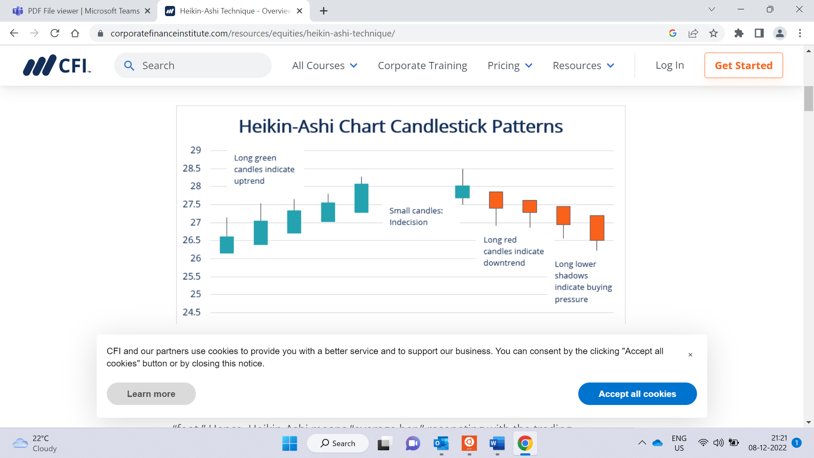

Slide 9
FLOWCHART
Start
User Enters into the Application
Display Stocks
Choose Stocks
Recommendation
R-G
G-R
Buy
Hold
Sell

Slide 10
DATAFLOW DIAGRAM LEVEL 0
Stocks
Technical Analysis Stock Screener
R-G
Buy
Stocks
List of Stocks
G-R
Sell
Hold

Slide 11
DATAFLOW DIAGRAM LEVEL1
List of Stocks
Choose Stock
View Stock Average Case
Enter in Application
Technical Analysis Stock
Diagram
User
List of Stocks
R-G
Buy
Stocks
Recommended
G-R
Sell
Hold

Slide 12
System Architecture

Slide 13
System Architecture
start
user
Create
Stock details
Such as stock id, stock name,
Stock low,
Stock high, stock volume
Append and update stock details up to 20 stocks and display
Recommend to buy or sell based on Heikin Ashi candle stick colour changing pattern

Slide 14
FUNCTION DESCRIPTION
void create(): Given the stock details as input like stock_Id,stock_name,stock_open,stock_prevclose,stock_low,stock_high,stock_volume.
void display(): This function is used to Display all the stock details which given as input.
void append(): This function is use to add extra stocks.
void update(): This function is used to update the stock values.
void delete_rec(): This function is used to delete the stock values.

Slide 15
CODING AND EXECUTION

Slide 16
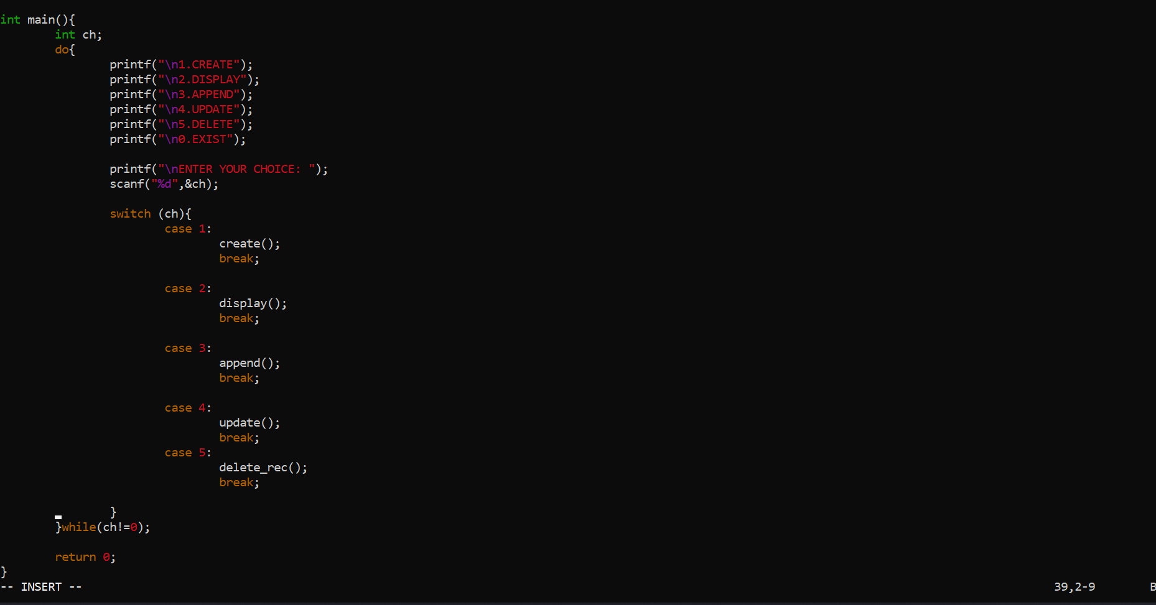
CODING AND EXECUTION

Slide 17
STOCK OPERATIONS
Create Stocks
Display Stocks
Add Stocks
Update Stocks
Delete Stocks

Slide 18
INTEGRATION TESTING

Slide 19
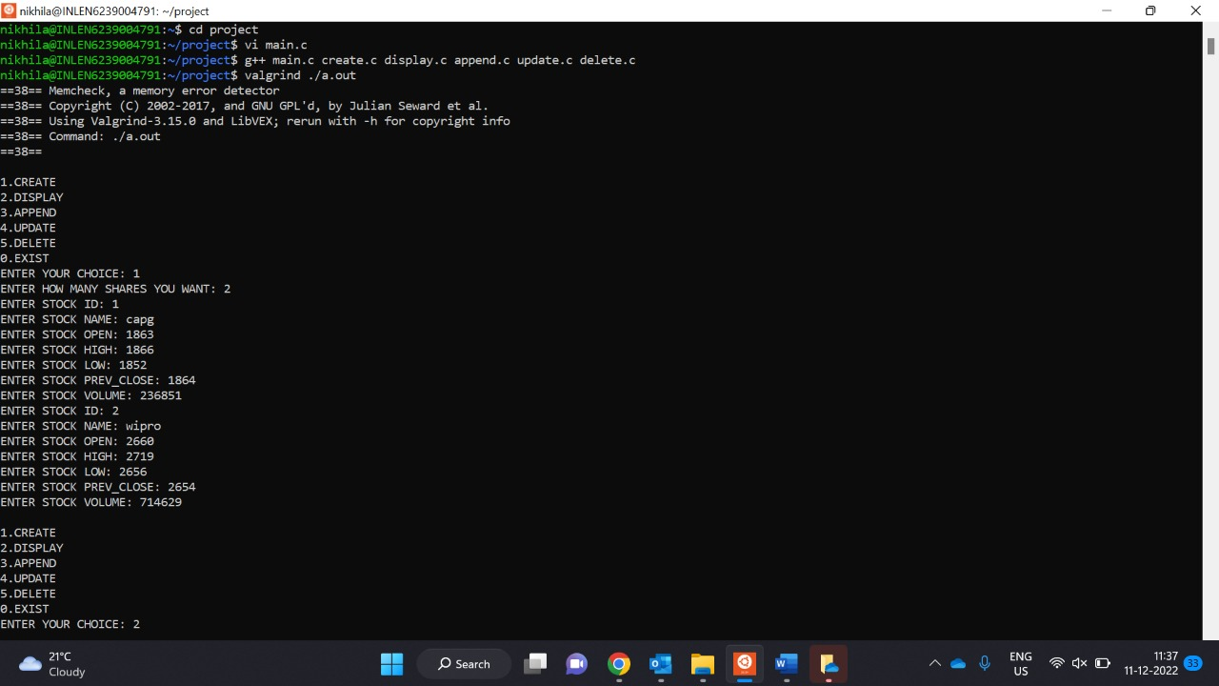
CREATE STOCKS OUPUT

Slide 20
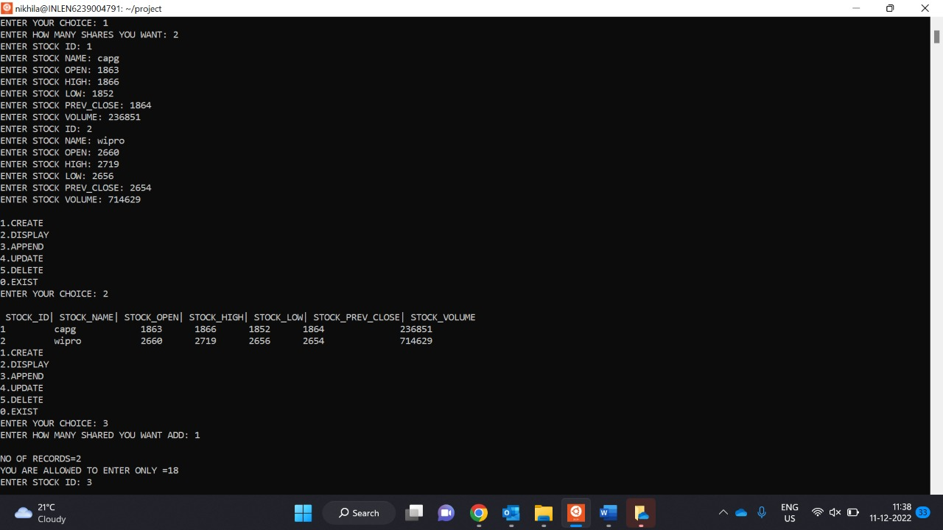
DISPLAY STOCKS OUTPUT

Slide 21
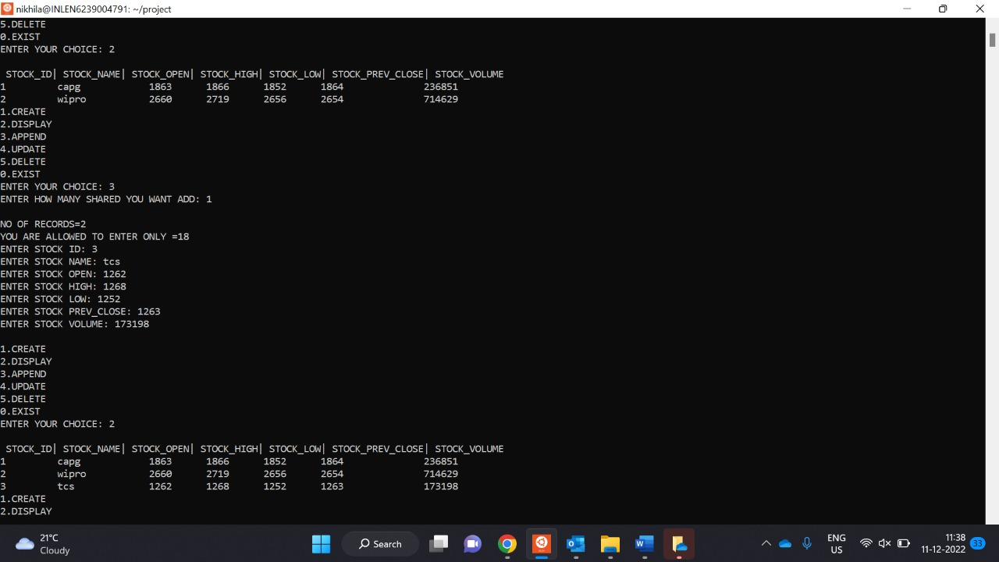
APPEND STOCKS OUTPUT

Slide 22
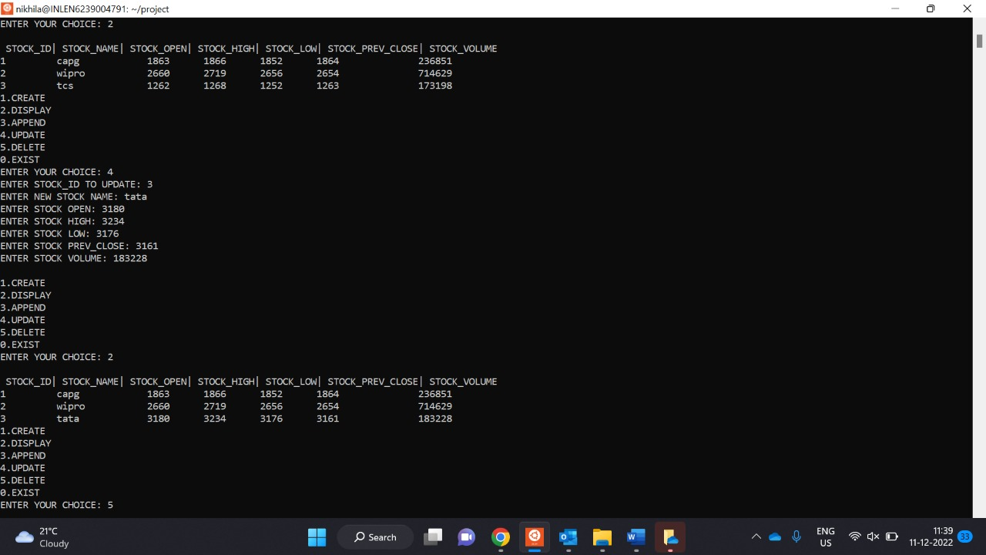
UPDATE STOCKS OUTPUT

Slide 23
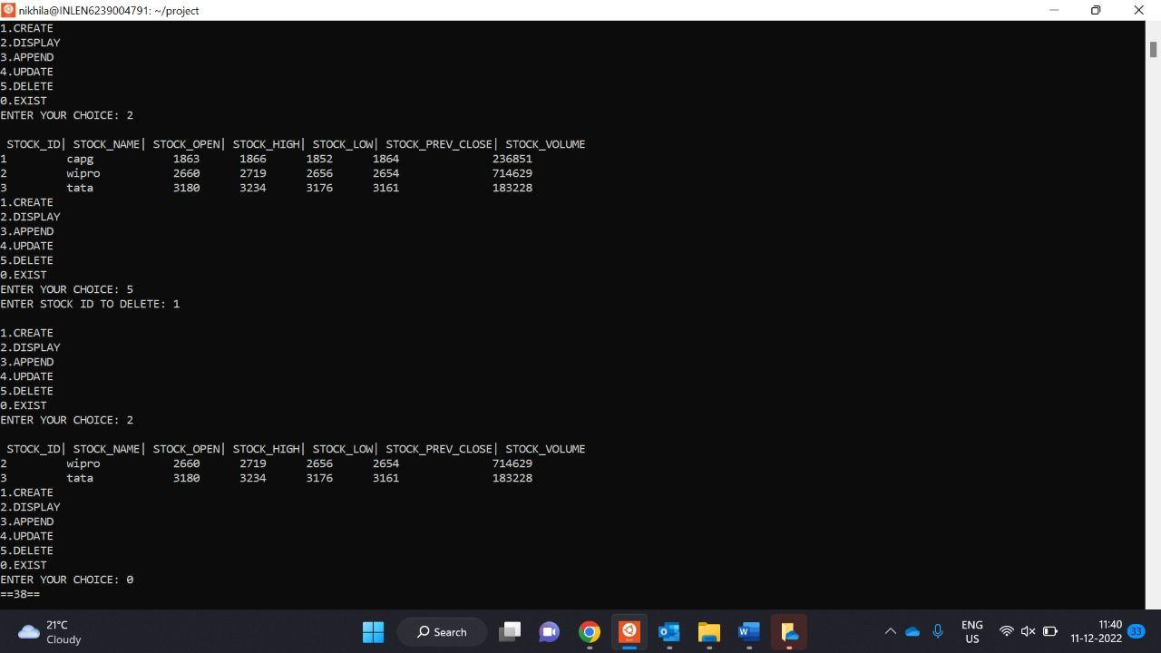
DELETE STOCKS OUTPUT

Slide 24
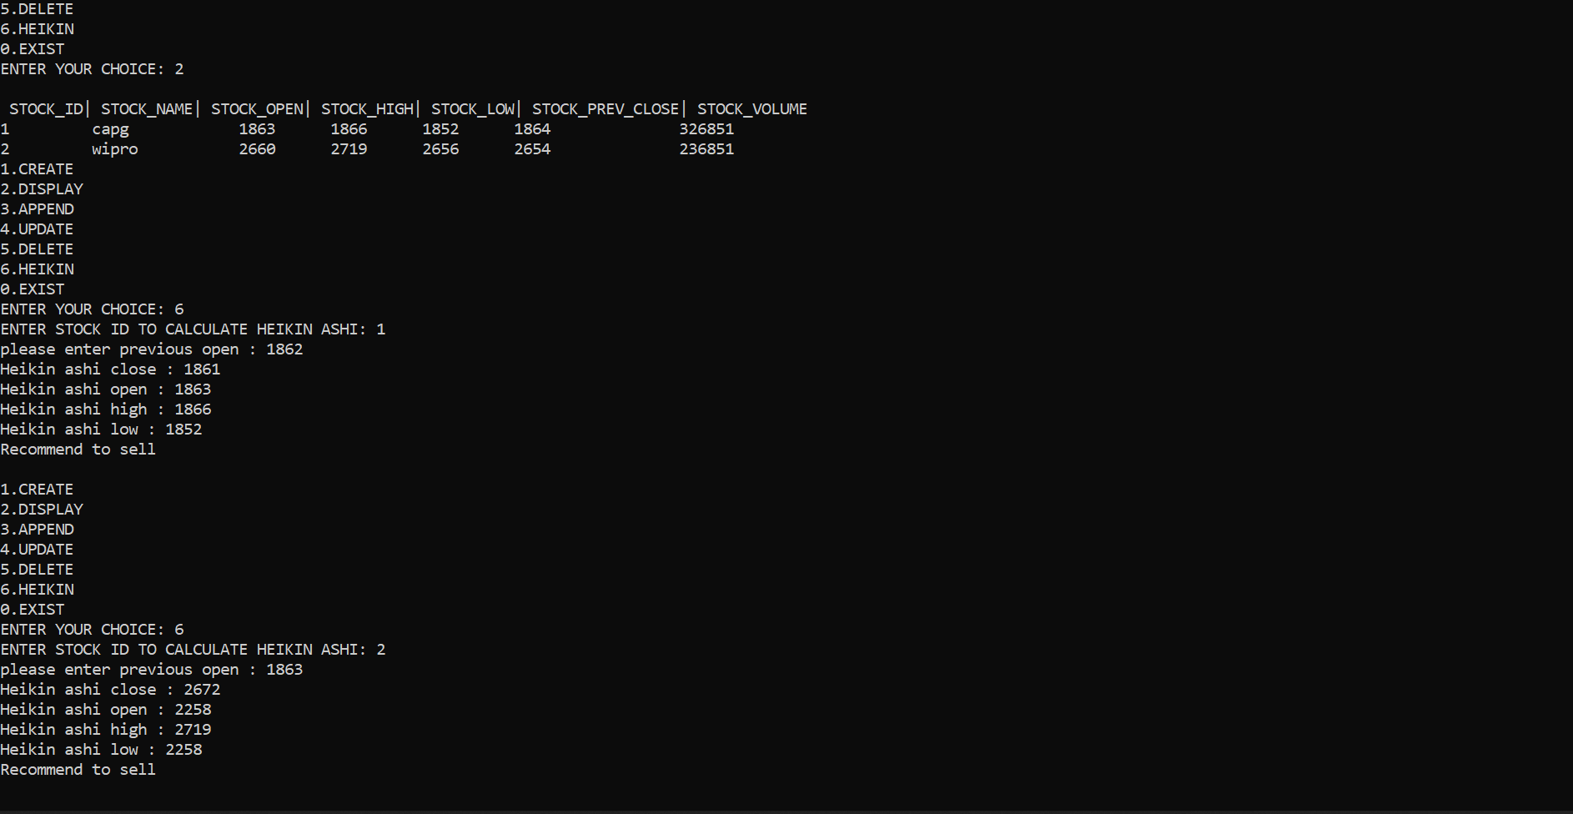
Heikin Ashi

Slide 25
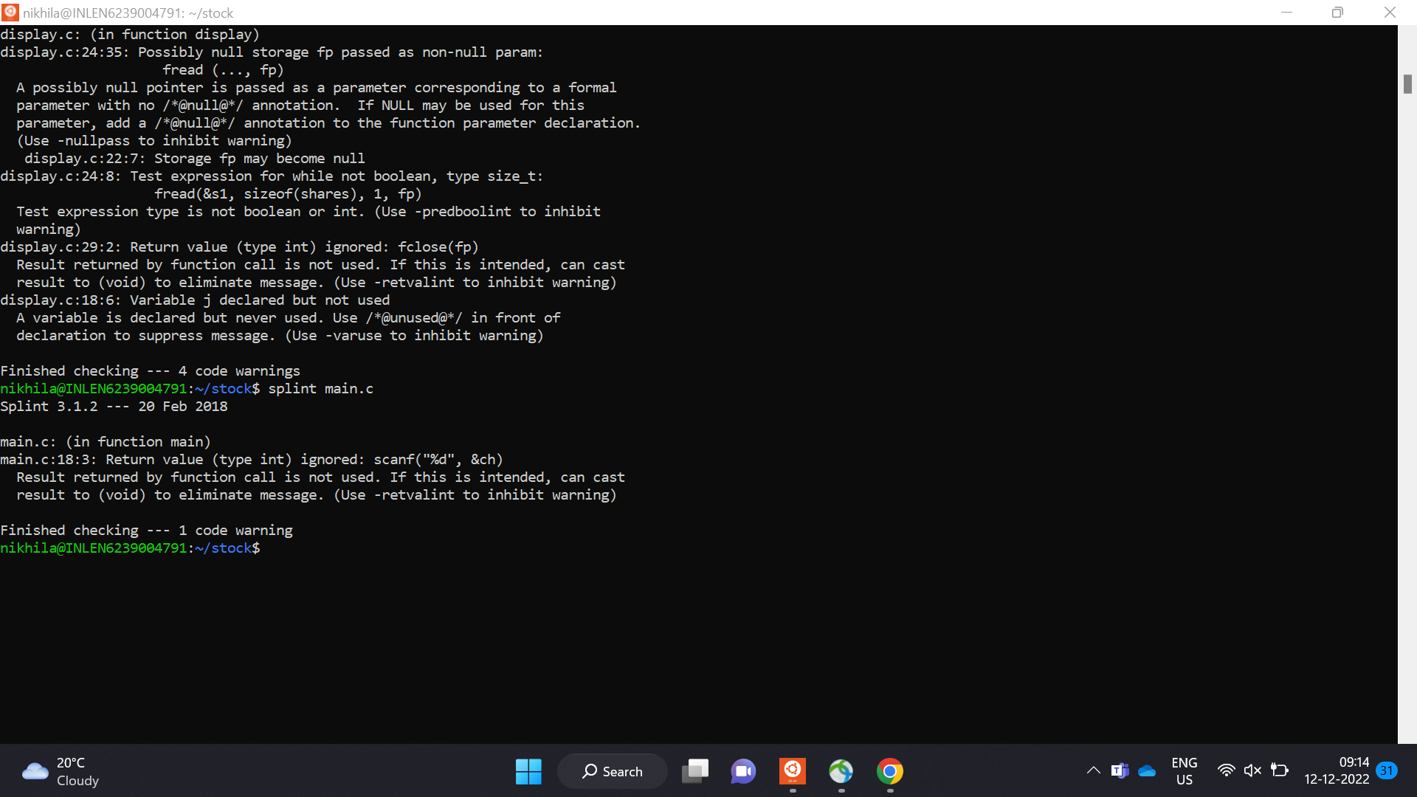
Splint Report

Slide 26
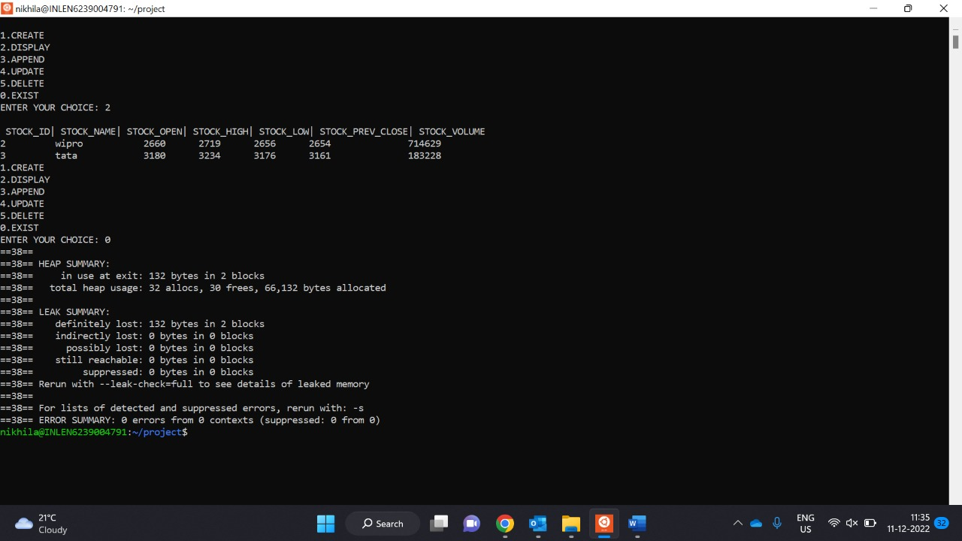
VALGRIND REPORT

Slide 27
conclusion
Successfully completed the coding and testing phases as per the given problem statement.
In this project stock details are created and operations are performed.
With the help of technical analysis screener, people are recommended to buy/sell stocks using algorithm of Heikin Ashi Candle stick colour changing pattern .

Slide 28


